Slide 1
Multidisciplinary Projects
Class 3: User Experience

Slide 2
Agenda
Usability and user interfaces
Web-mobile user interfaces
User-testing evaluation

Slide 3
Learning Objectives
Understanding the user interfaces.
Three-layers architecture.
Understanding the evaluation of user interfaces.

Slide 4
The Importance of the User Experience
A computer system is only as good as the experience it provides to its users. If a system is hard to use:
users may fail to find important results, or misinterpret what they do find
users may give up in disgust
Appropriate functionality, easy navigation, elegant design, and fast response times make a measurable difference to a system’s effectiveness
Usability is more than user interface design.
Good support for users is more than a cosmetic flourish
Developing good user interfaces needs skill and time.

Slide 5
Terminology
The user experience is the total of all the factors that contribute to the usability (or otherwise) of a computer and its systems.
Human Computer Interaction (HCI) is the academic discipline that studies how people interact with computers

Slide 6
Development Processes for User Interfaces
It is almost impossible to specify an interactive or graphical interface in a textual document
Requirement benefit from sketches, comparison with existing systems, etc.
Designs should include graphical elements and benefit from a mock-up or other form of prototype.
User interfaces must be tested with users. Expect to change the requirements and design as the result of testing.
Schedules should include user testing and time to make changes.
Whatever process you use to develop a software system, the development of the user interface is always iterative.

Slide 7
The Analyze/Design/Build/Evaluate Loop

Slide 8
Tools for Usability Requirements and Evaluation

Slide 9
Tools for Usability Requirements: Mock-up

Slide 10
Tools for Usability Requirements: Focus Group
A focus group is a group interview
Interviewer
Potential users
Typically 5 to 12
Similar characteristics (e.g., same viewpoint)
Structured set of questions
May show mock-ups
Group discussions
Repeated with contrasting user groups

Slide 11
Accessibility Requirements
Software designers must be prepared to users with disabilities (e.g., poor eyesight, lack of hearing, poor manual dexterity), or limited knowledge of English, etc.
Requirements about accessibility are most likely to arise in the user interface.
You may have a legal requirement to support people with disabilities.

Slide 12
Equipment Requirements
There may also be requirements to support computers with poor performance, limited screen sizes, bad network connections, etc.
Be explicit about the equipment assumptions that you make and how to handle failures. Do user testing with both good and bad equipment.
Example: MacMail has a requirement that operations terminate cleanly if the network connection is lost, but its behavior is erratic if the network connection becomes extremely slow, e.g., it will not quit.

Slide 13
Design from a System Viewpoint

Slide 14
Mental Models
A mental model is what a user thinks is true about a system, not necessarily what is actually true.
A mental model should be similar in structure to the system that is represented.
A mental model allows a user to predict the results of his/her actions.
A mental model is simpler than the represented system. It includes only enough information to allow reasonable predictions.
A mental model is also called a conceptual model.

Slide 15
User Interface Design: Navigation
Getting the navigation right is central to the user experience. Applications consist of one or more pages (web) or screens (mobile apps).
Web: loading a new page uses the network and is therefore slow
Smartphone or tablet: loading a new screen is usually instantaneous
The first step in user interface design is to choose what pages or screens to use.
What functionality is provided on each screen?
How are the screens organized?
How does the user know what screens are available?
How does the user move between screens?

Slide 16
User Interface Design: Organization of Pages and Screens
The organization of the pages must match the user’s mental model. Keep it simple.
Organization of pages in a web application.
The basic building block of the web is a hyperlink. This allows any page to link to any other page. This is flexible, but can lead to confusing applications.
Many web sites use a hierarchical tree structure.
When a user leaves a page, the state is lost unless explicitly saved.

Slide 17
User Interface Design: Organization of Pages and Screens (cont.)
Organization of screens in a mobile app
Both Android and iOS encourage the use of a stack based architecture.
When a user leave a screen, the state is pushed onto a stack and is available when the screen is next used.
Indicate to the user what pages are available and how to reach them.

Slide 18
Mental Models (cont.)
The mental model is the user's model of what the system provides.
The computer model may be quite different from the user’s mental model.
Example: the desktop metaphor
mental model — one vast collection of pages, which are searched on request
computer model — a central index, which is searched on request
Example: web search
mental model — one vast collection of pages, which are searched on request
computer model — a central index, which is searched on request

Slide 19
Mental Models vs. Computer Model
The mental model is that the photograph is embedded in the text of the document…
but in the computer model the photograph is an independent file, which could be changed separately.

Slide 20
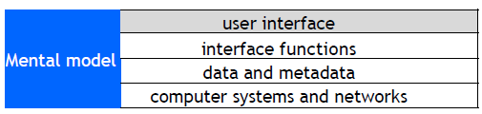
User Interface Design
The user interface is the appearance on the screen and the actual manipulation by the user
Fonts, colors, logos, keyboard controls, menus, buttons
Mouse control, touch screen, or keyboard control
Conventions (e.g., "back", "help")

Slide 21

User Interface Design (cont.)
Example: to leave full screen
Keyboard: escape key, control-F Mouse/touch:
Examples of design choices
Screen space utilization in Adobe Reader.
Number of snippets per page in web search.

Slide 22
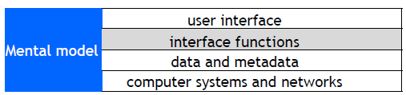
Interface Functions
The interface functions determine the actions that are available to the user:
Select part of an object
Search a list or sort the results
View help information
Manipulate objects on a screen
Pan or zoom

Slide 23
Interface Functions (cont.)
There may be alternative user interface designs for the same interface functions, for example:
Different versions of the MS Windows desktop have most of the same interface functions, but different user interface designs.
Applications that run on both Windows and Macintosh computers support a one-button mouse (Macintosh) o a two-button mouse (Windows).

Slide 24
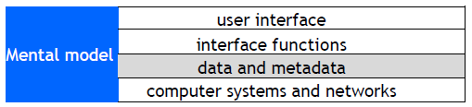
Data and Metadata
The interface functions and the interface design provide an interface to the data and metadata stored by the computer system.
The desktop metaphor has the concept of associating a file with an application. This requires a file type to be stored with each file:
extension to filename (e.g., .txt, .pdf)
Inexperienced clients sometimes ask for interface features that require additional data or metadata.

Slide 25
Data and Metadata (cont.)

Slide 26
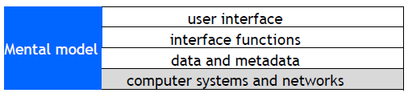
Computer Systems and Networks
The performance, reliability and predictability of computer systems and networks are crucial factors.

Slide 27
Computer Systems and Networks (cont.)
Examples
Instantaneous response time is essential for mouse tracking.
Response time for transactions may determine the action taken, e.g., approve credit card if no reply within five seconds.
Response time requirements
0.1 sec – the user feels that the system is reacting instantaneously
1 sec – the user will notice the delay, but his/her flow of thought stays uninterrupted
10 sec – the limit for keeping the user's attention focused on the dialogue
As computer systems improve, users have got more demanding. A response time that is good enough today, may not be good enough five years from now.

Slide 28
Principles of User Interface Design
User interface design is partly an art, but there are general principles
Consistency -- in appearance, controls, and function.
Feedback -- what is the computer system doing? Why does the user see certain results?
Users should be able to interrupt or reverse actions.
Error handling should be simple and easy to comprehend.
Skilled users should be offered shortcuts; beginners should have simple, well-defined options.
The user should feel in control

Slide 29
Avoid the Fancy

Slide 30
Simple is Good

Slide 31
Interface Design: Menus
Easy for users to learn and use
Certain categories of error are avoided
Enables context-sensitive help
Major difficulty is structure of large number of choices
Scrolling menus (e.g., states of USA)
Hierarchical
Associated control panels
Menus plus command line
Users prefer broad and shallow to deep menu systems

Slide 32
Help System Design
Help system design is difficult
Must prototype with mixed users
Must have many routes to same information
Categories of help:
Overview and general information
Specific or context information
Tutorials (general)
Cook books and wizards
Emergency ("I am in trouble ...")
Help systems need experienced designers. Schedule plenty of time for development and user testing.

Slide 33
Information Presentation
Simple is often better than fancy
Text
precise, unambiguous
fast to compute and transmit
Graphical interface
simple to comprehend/learn, but icons can be difficult to recognize
uses of color
variations show different cases

Slide 34
Command Line Interfaces
Problems with graphical interfaces
Not suitable for some complex interactions
May be slow for skilled users
Difficult to build scripts
Only suitable for human users

Slide 35
Command Line Interfaces
User interacts with computer by typing commands (e.g., Linux shell script)
Allows complex instructions to be given to computer
Facilitates formal methods of specification & implementation
Skilled users can input commands quickly
Unless very simple, requires learning or training
Can be adapted for people with disabilities
Can be multi-lingual
Suitable for scripting/ non-human clients

Slide 36
Device-Aware Interfaces
Interfaces must take into account physical constraints of computers and networks:
How does a desk-top computer differ from a laptop?
What is special about a smartphone?
How do you make use of a touch-sensitive screen?
What works well with a digital camera?
Constraints that the interface must allow for:
performance of device (e.g., fast or slow graphics)
limited form factor (e.g., small display, no keyboard)
connectivity (e.g., intermittent)

Slide 37
Networks
Operations that transfer data over the network have unpredictable response times and are subject to delay.
Large data transfers should run asynchronously in a separate thread.
Provide visual feedback to indicate that the operation is in progress.
Provide a way for users to cancel long running data transfers

Slide 38
Smartphones and Tablets: Screen Size
Smartphones and tablets have small screens. Every small area is important.
There is big difference in screen size between a small smartphone and a large tablet.
There may be different layouts or even different version for different screens.
Apps need to have different layouts for portrait and landscape.
Apps need to be tested with a full range of screen sizes and orientations.
Some apps may be optimized for a large screen.
Use a simulator to see how your app looks on various devices.

Slide 39
Smartphones: Accessibility
Smartphones have small displays and small virtual keyboards. Some apps rely on speech or other sound signals.
People with poor eyesight, color blindness, hearing loss, or clumsy fingers may have difficulty using your applications.
Android and iOS provide numerous accessibility features and provide online advice about how to build accessible apps.
For your user testing try to find people who do not have perfect eyesight, hearing, etc. Have testers of various ages. Older people are often less able to use touch sensitive screens.

Slide 40
Screen Size: Responsive Web Design
Responsive web design adjusts how web pages are viewed based on the size of the screen, or other characteristics of the device or browser used to view the page.
Media queries in CSS (Cascading Style Sheet) allow the page to use different CSS style rules based on characteristics of the device the site is being displayed on, e.g., the width of the browser window.
For example. You develop a web site using a laptop computer. How will it look on a smartphone?

Slide 41
Responsive Web Design
Browsers such as Chrome, Firefox, and Safari have options that allow you to see how your site would appear on other devices.
The ideal:
A single web site adapts to any device by using a mix of flexible grids and layouts, and careful use of CSS media queries.
In practice:
Mobile devices, such as smartphones, are so different from regular computers that it is extremely difficult to create a web site that works well on all devices.

Slide 42
Responsive Web Design (cont.)
For example:
Less content can be displayed on a small screen than on a large screen.
Smartphones are usually used in portrait; computer screens are landscape.
A touch screen has different characteristics from a mouse, e.g., the user cannot hover over a menu item.
A virtual keyboard needs screen space.

Slide 43
Responsive Web Design (cont.)
Major web sites have several versions of the site for different devices.
They identify the user’s device and automatically provide the version designed for that type of device.
This Safari example shows the New York Times mobile version of the web site on a small iPhone.
The next slide, from Firefox, shows the same page on a laptop computer.

Slide 44
Responsive Web Design (cont.)

Slide 45
Navigation: User Testing
Before building an application, test the navigation.
Create simple mock-ups, e.g., rough sketches.
Create a large number of simple scenarios. They should show all the main paths through the application, including user mistakes, system problems, etc.
Step through the scenarios with the client and potential users.
Later in the development process, these scenarios can be used for user interface design, program design, and all forms of testing.
It is much easier to make changes in the basic navigation before beginning the detailed user interface design and implementation.

Slide 46
Mobile Apps: Development Environments
App development is complex. Most apps are built using development environments such as Android Studio and Apple’s Xcode.
There are good tutorials and good documentation online. I strongly recommend that you work through a tutorial before attempting to build a real app.
If you are new to Android or iOS development allow plenty of learning time.
For your project try to have several team members with previous experience of the development environment that you are using.

Slide 47
Mobile Apps: Development Environments (cont.)
These environments are moderately flexible for user interface design. They support a variety of ways to navigate, user interface objects, etc. But they have limitations (e.g., iOS does not have a radio button).
To build a good user experience, understand and adopt the style of the development environment.
Users will be familiar with the style of interface from other apps.
The interface objects are well designed with good technical implementation.
The objects are intended to be used on a variety of devices.
When new versions of the operating systems are released, the designs will need few modifications.

Slide 48
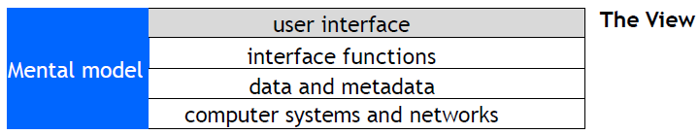
Model-View-Controller: The View
Most modern development environments use one of the many variations of the Model-View-Controller architecture.
In the Model-View-Controller architecture, the user interface is called the View.
Many of the interface functions are implemented by user interface widgets that are provided by the development environment.
The development environment may also provide recommended styles for the user interface, e.g., fonts, graphical elements.

Slide 49
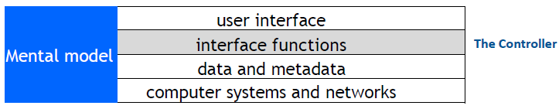
Model-View-Controller: The Controller
In the Model-View-Controller architecture, the interface functions are invoked by the Controller.
The Controller manages the flow of control of the whole user interface and connects the View to the Model.

Slide 50
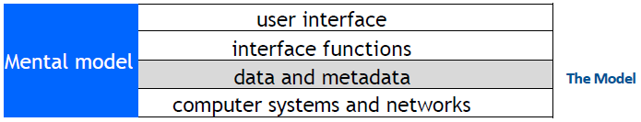
Model-View-Controller: The Model
In the Model-View-Controller architecture, the data and metadata are maintained by the Model.
The Model also manages the logic of all parts of the system that are not part of the user interface.

Slide 51
Mobile Apps: the Design Challenge
How do you design a user interface with no instructions, no user manual, no training?
Look: Characteristics of the appearance that convey information.
Feel: Interaction techniques that are intuitive and provide satisfactory experience.
Metaphors and mental models: Mental models and metaphors. But there may not be an intuitive model.

Slide 52
Mobile Apps: the Design Challenge (cont.)
Navigation rules: How to move among data, functions, and activities in a large space.
Conventions: Familiar aspects that do not need extra training – good for users, good for designers, e.g., scroll bars, buttons, gestures, help systems, sliders.

Slide 53
Mobile Apps: Development Environments
Development environments include standard classes that provide templates for navigation and the layout of screens.
Designs that incorporate these classes can use services, APIs, etc. that the operating environment provides.
This example uses an iOS TableViewController.
Because the length of tables can be very long, iOS implements a TableViewController in a manner that makes efficient use of storage and processing power.

Slide 54

Mobile Apps: Conventions
Development environments encourage consistent apps.
You may never have used this app, but look at how many aspects feel familiar.

Slide 55
Design Tensions in Web and Mobile Applications
Designers wish to control what the user sees, but users wish to configure their own environments.
Client computers and network connections vary greatly in capacity.
Client software may run on various operating systems, which may not be the current version.
Accessibility requires that designers do not take control of parameters such as font size.
Be explicit about the assumptions you make about the user's computer, web browser, etc. In using style sheets, such as CSS, avoid over-riding user preferences.

Slide 56
Usability and Cost
User interface development may be a major part of a software development project
Good usability may be expensive in hardware or special software development
Costs are multiplied if a user interface has to be used on different computers or migrate to different versions of systems
Design users interfaces that can be built with standard tools:
Web browsers provide a general purpose user interface where others maintain the user interface software.
Use the standard classes that the development environment provides.

Slide 57
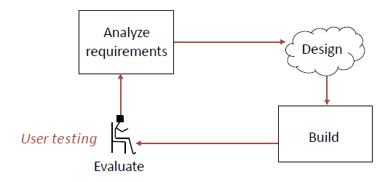
The Analyze/Design/Build/Evaluate Loop
Whenever possible, the design and evaluation should be done by different people.

Slide 58
Evaluation
If your system has users, the schedule should include time for user testing and time to make changes after the user testing is completed.
When to do evaluation
Iterative improvements during development.
Making sure that a system is usable before launching it.
Iterative improvements after launch.
Methods of evaluation
Empirical evaluation with users (user testing)
Measurements on operational systems
Analytical evaluation: without users

Slide 59
Evaluation
How do you measure usability? Usability comprises the following aspects:
Effectiveness
The accuracy and completeness with which users achieve certain goals
Measures: quality of solution, error rates
Efficiency
The relation between the effectiveness and the resources expended in achieving them
Measures: task completion time, learning time, number of clicks
Satisfaction
The users' comfort with and positive attitudes towards the use of the system

Slide 60
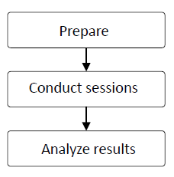
Evaluation with Users
Stages of evaluation with users:
User testing is time-consuming, expensive, and essential

Slide 61
Evaluation with Users: Preparation
Determine goals of the usability testing
“Can a user find the required information in no more than 2 minutes?”
Write the user tasks
“Given a new customer application form, add a new customer to the customer database.”
Recruit participants
Use the descriptions of users from the requirements phase to determine categories of potential users and user tasks

Slide 62
Usability Laboratory
Concept: monitor users while they use system

Slide 63
Evaluation with Users: Sessions
Conduct the session
Usability Lab
Simulated working environment
Observe the user
Human observer(s)
Video camera
Audio recording
Inquire satisfaction data

Slide 64
Evaluation: Number of Users
A great deal can be learned from user testing with a small number of users, even as few as five people.
Try to find different types of user (young/old, experienced/beginners, etc.).
Prepare carefully.
Combine structured tests with free form interviews.
Have at least two evaluators for every test.

Slide 65
Results Analysis
Test the system, not the users
Respect the data and users' responses. Do not make excuses for designs that failed.
If possible, use statistical summaries.
Pay close attention to areas where users:
were frustrated
took a long time
could not complete tasks
Note aspects of the design that worked and make sure they are incorporated in the final product.

Slide 66
Eye Tracking

Slide 67
EyeTracking

Slide 68
EyeTracking

Slide 69
Project: Methodology
The next few slides are from a presentation
How we’re user testing:
One-on-one, 30-45 min user tests with staff levels Specific tasks to complete
No prior demonstration or training
Pre-planned questions designed to stimulate feedback
Emphasis on testing system, not the stakeholder!
Standardized tasks /questions among all testers

Slide 70
Project: Methodology (cont.)
Types of questions we asked:
Which labels, keywords were confusing? What was the hardest task?
What did you like, that should not be changed? If you were us, what would you change?
How does this system compare to your paper based system
How useful do you find the new report layout? (admin)
Do you have any other comments or questions about the system? (open ended)

Slide 71
A Project: Results
What we’ve found: Issue #1, Search Form Confusion!

Slide 72
A Project: Results
What we’ve found: Issue #2, Inconspicuous Edit/ Confirmations!

Slide 73
A Project: Results
What we’ve found: Issue #3, Confirmation Terms

Slide 74
A Project: Results
What we’ve found: Issue #4, Entry Semantics

Slide 75
A Project: Results
What we’ve found: #5, Search Results Disambiguation & Semantics

Slide 76
Evaluation based on Measurement
Basic concept: log events in the users’ interactions with a system
Examples from a Web system
Clicks (when, where on screen, etc.)
Navigation (from page to page)
Keystrokes (e.g., input typed on keyboard)
Use of help system
Errors May be used for statistical analysis or for detailed tracking of individual user.

Slide 77
Evaluation based on Measurements
Analysis of system logs
Which user interface options were used?
When was the help system used?
What errors occurred and how often?
Which hyperlinks were followed (click through data)?
Human feedback
Complaints and praise
Bug reports
Requests made to customer service

Slide 78
Refining the Design based on Evaluation
Do not allow evaluators to become designers
Designers are poor evaluators of their own work, but know the requirements, constraints, and context of the design:
Some user problems can be addressed with small changes
Some user problems require major changes
Some user requests (e.g., lots of options) are incompatible with other requests (e.g., simplicity)
Designers and evaluators need to work as a team

